Slide 1
JAVA Immutable

Slide 2
Immutable Objects
An object is considered immutable if its state cannot change after it is constructed. Maximum reliance on immutable objects is widely accepted as a sound strategy for creating simple, reliable code. Immutable objects are particularly useful in concurrent applications. Since they cannot change state, they cannot be corrupted by thread interference or observed in an inconsistent state.
Programmers are often reluctant to employ immutable objects, because they worry about the cost of creating a new object as opposed to updating an object in place. The impact of object creation is often overestimated, and can be offset by some of the efficiencies associated with immutable objects. These include decreased overhead due to garbage collection, and the elimination of code needed to protect mutable objects from corruption.
The following subsections take a class whose instances are mutable and derives a class with immutable instances from it. In so doing, they give general rules for this kind of conversion and demonstrate some of the advantages of immutable objects.

Slide 3
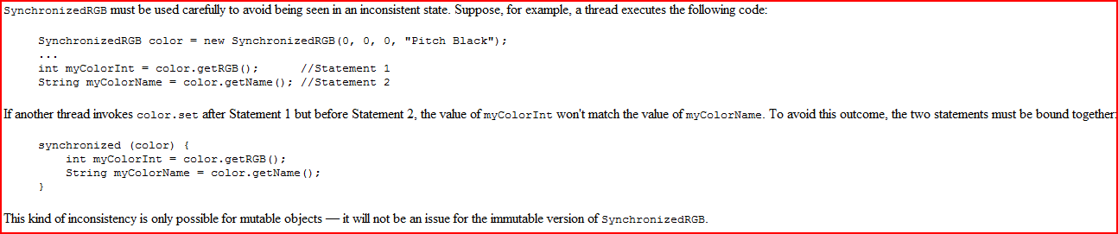
A Synchronized Class Example
The class, SynchronizedRGB, defines objects that represent colors. Each object represents the color as three integers that stand for primary color values and a string that gives the name of the color.

Slide 4


Slide 5
A Strategy for Defining Immutable Objects
The following rules define a simple strategy for creating immutable objects. Not all classes documented as "immutable" follow these rules. This does not necessarily mean the creators of these classes were sloppy — they may have good reason for believing that instances of their classes never change after construction. However, such strategies require sophisticated analysis and are not for beginners.
Don't provide "setter" methods — methods that modify fields or objects referred to by fields.
Make all fields final and private.
Don't allow subclasses to override methods. The simplest way to do this is to declare the class as final. A more sophisticated approach is to make the constructor private and construct instances in factory methods.
If the instance fields include references to mutable objects, don't allow those objects to be changed:
  Don't provide methods that modify the mutable objects.
  Don't share references to the mutable objects. Never store references to external, mutable objects passed to the constructor; if necessary, create copies, and store references to the copies. Similarly, create copies of your internal mutable objects when necessary to avoid returning the originals in your methods.
Applying this strategy to SynchronizedRGB results in the following steps:
There are two setter methods in this class. The first one, set, arbitrarily transforms the object, and has no place in an immutable version of the class. The second one, invert, can be adapted by having it create a new object instead of modifying the existing one.
All fields are already private; they are further qualified as final.
The class itself is declared final.
Only one field refers to an object, and that object is itself immutable. Therefore, no safeguards against changing the state of "contained" mutable objects are necessary.

Slide 6


